Slide 1
www.makeithappen.club

Slide 2

Thank You!

Slide 3
Inspiring ideas

Slide 4
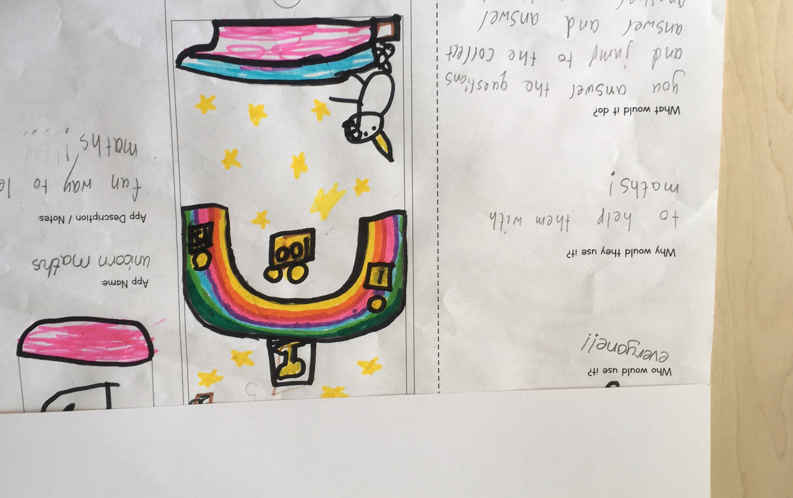
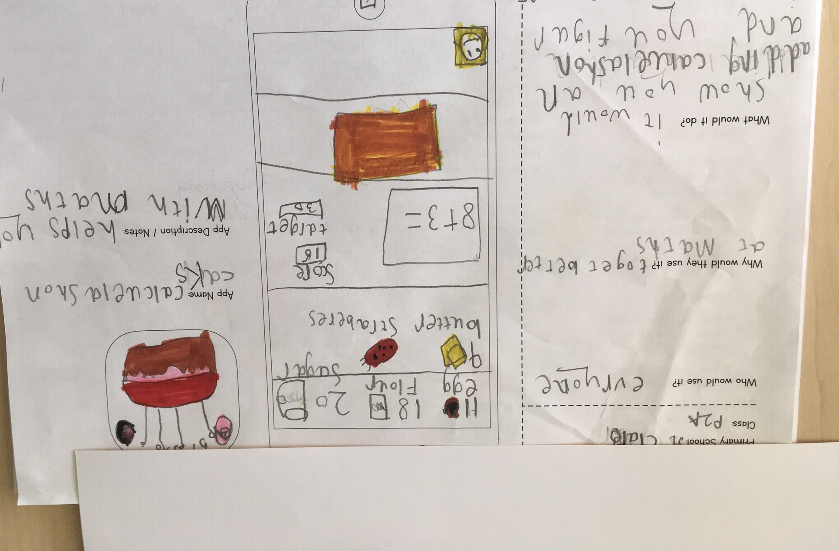
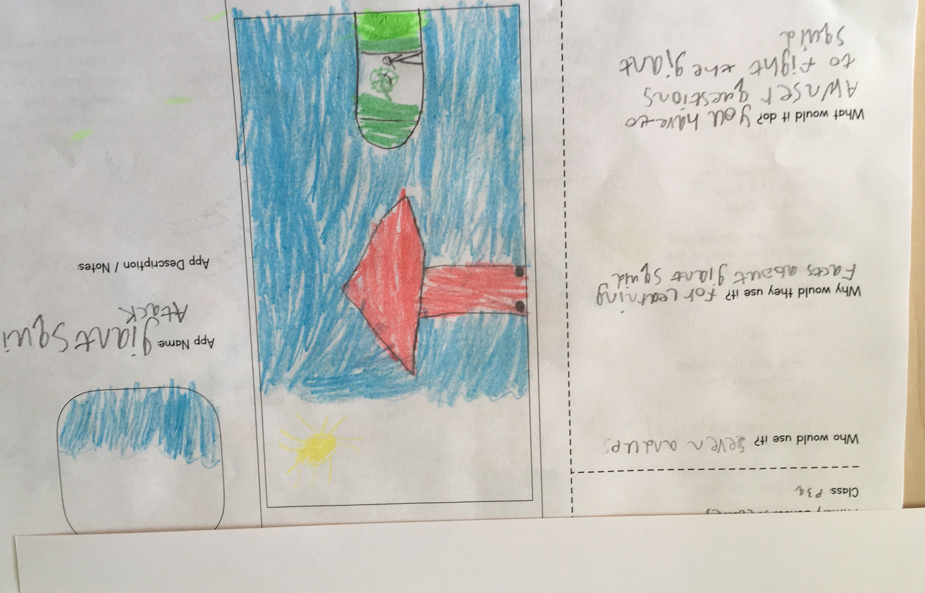
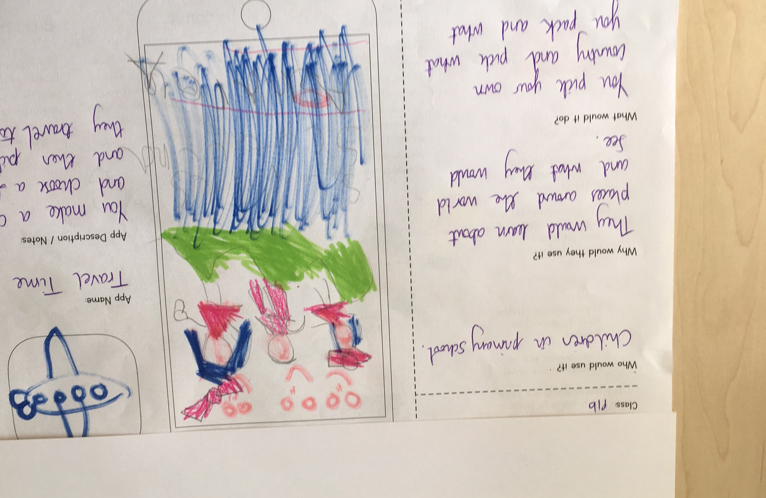
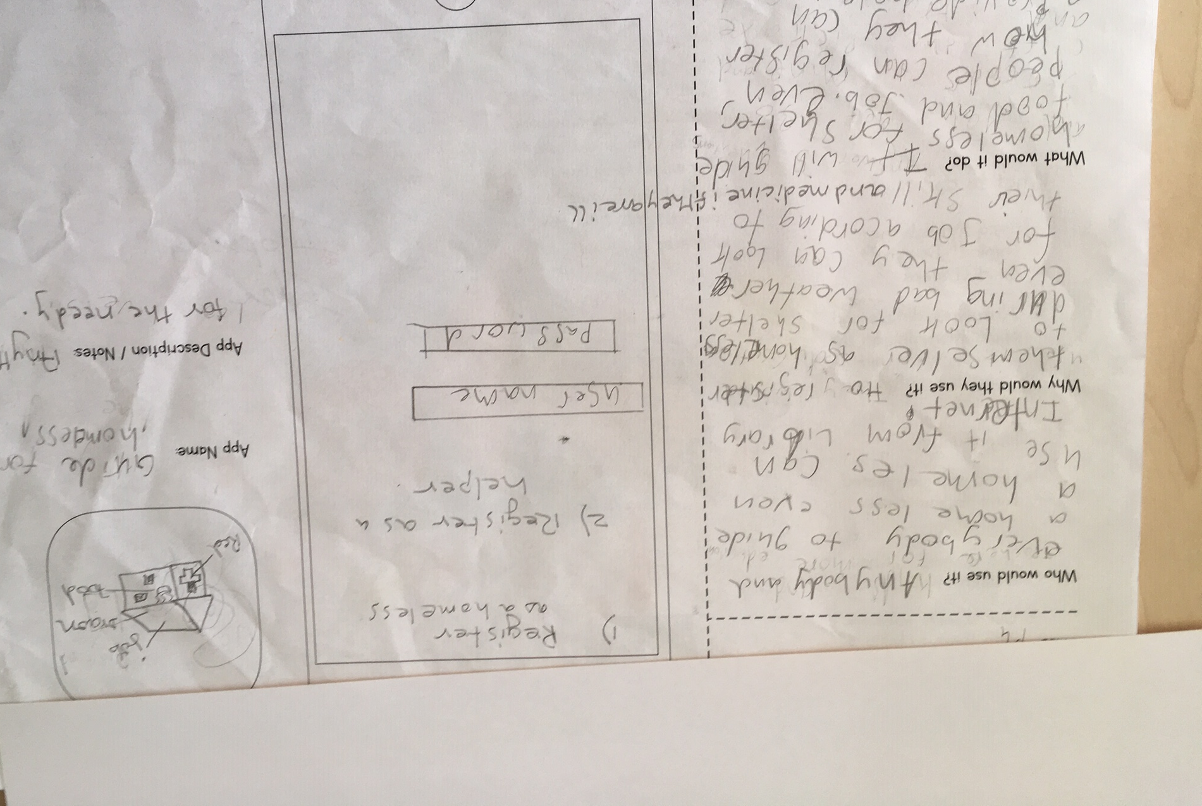
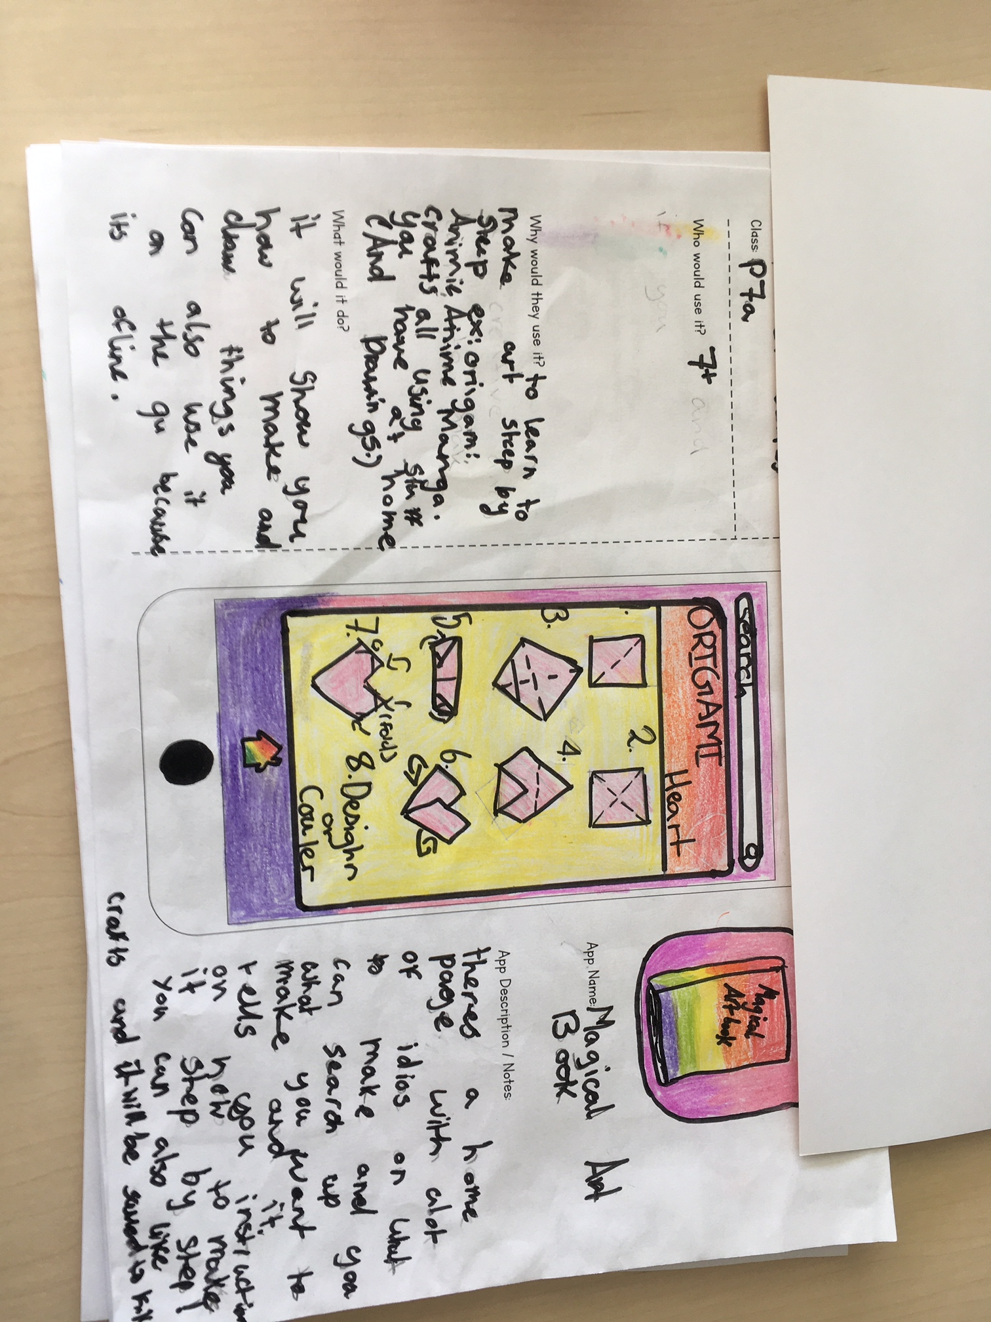
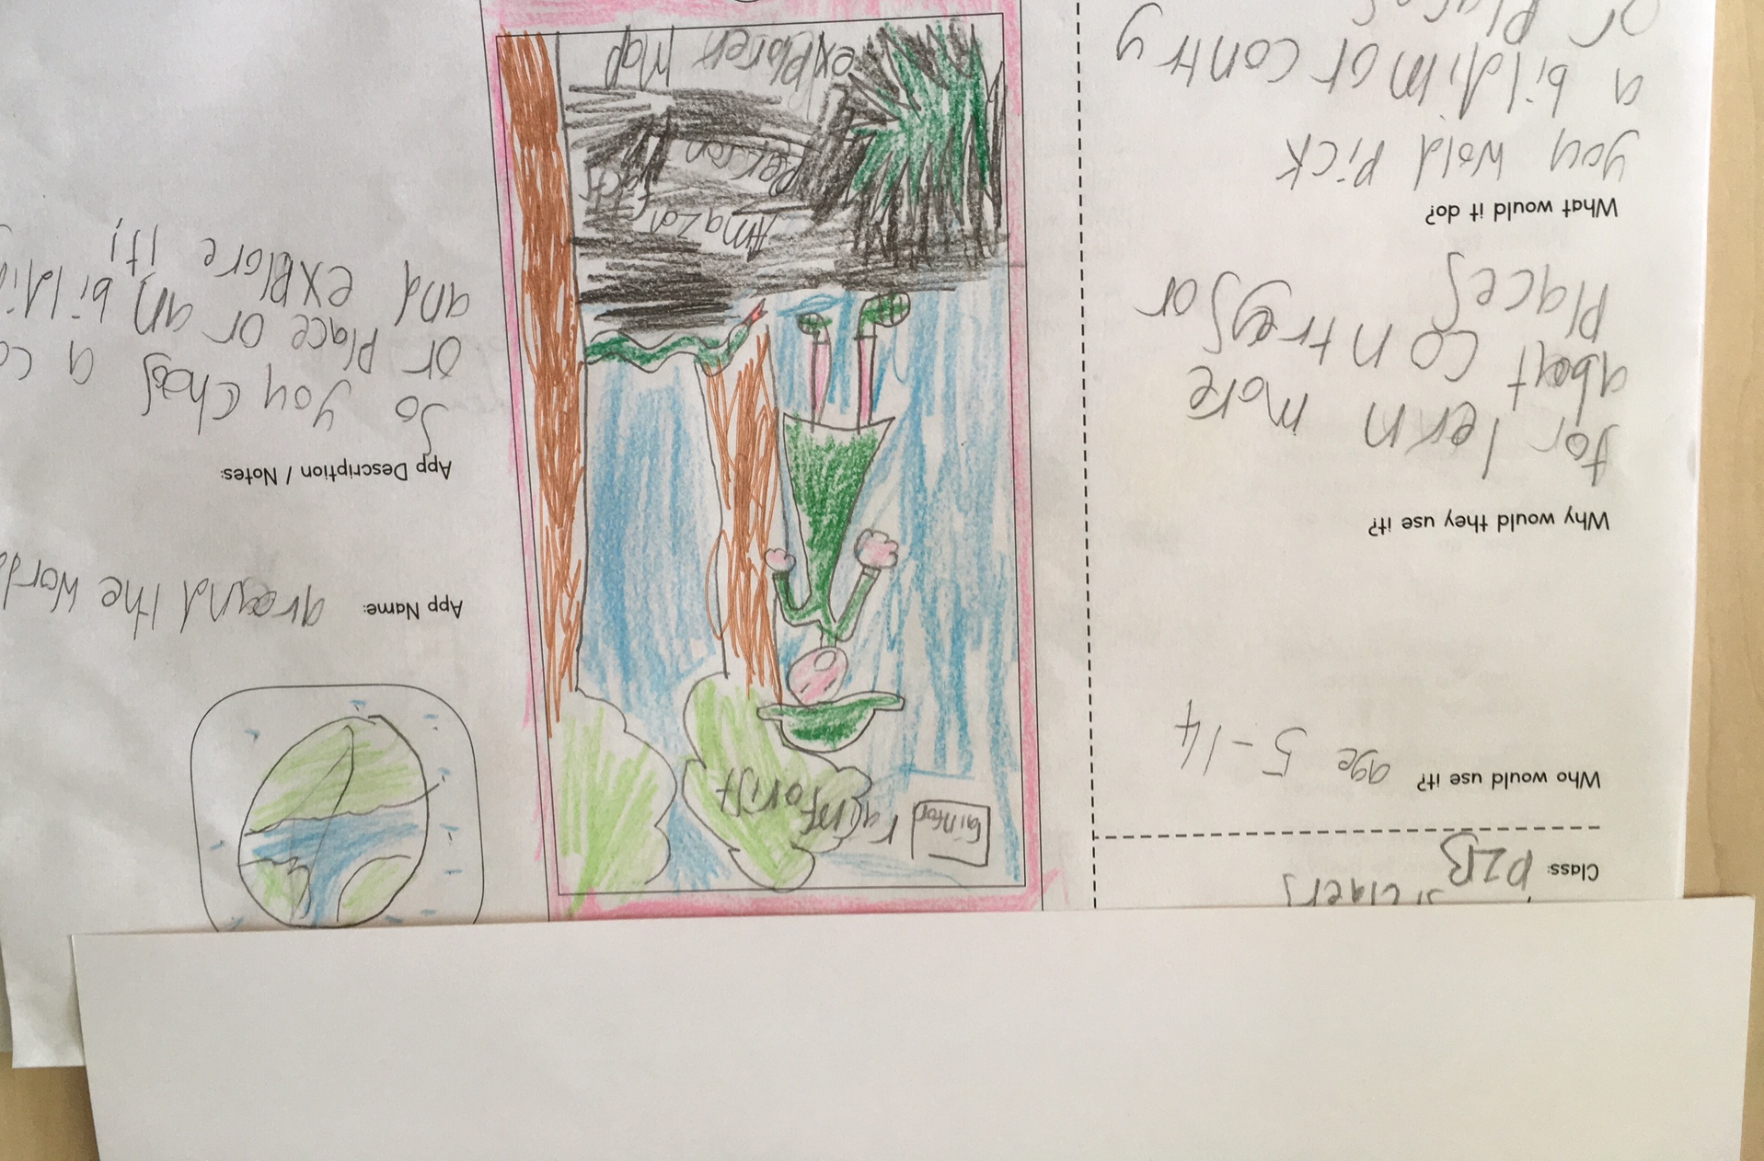
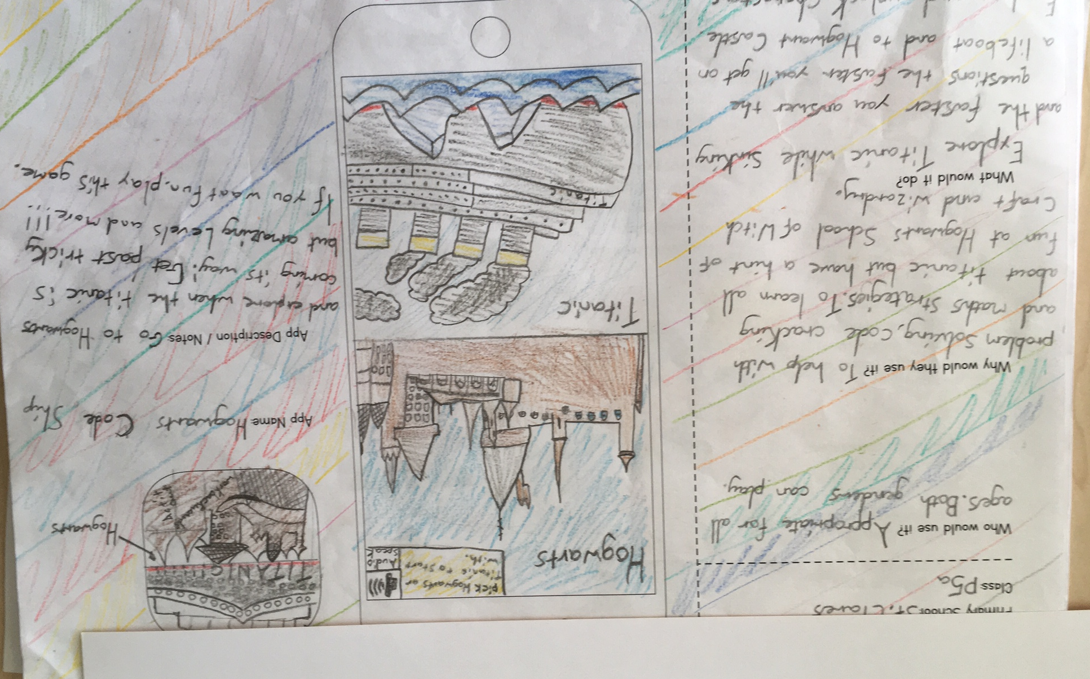
Inspiring ideas

Slide 5
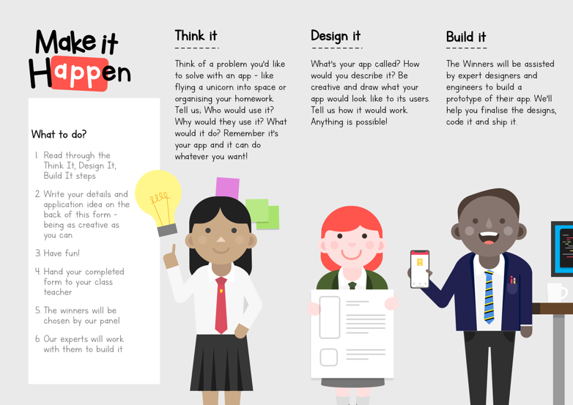
Runners up - 1

Slide 6
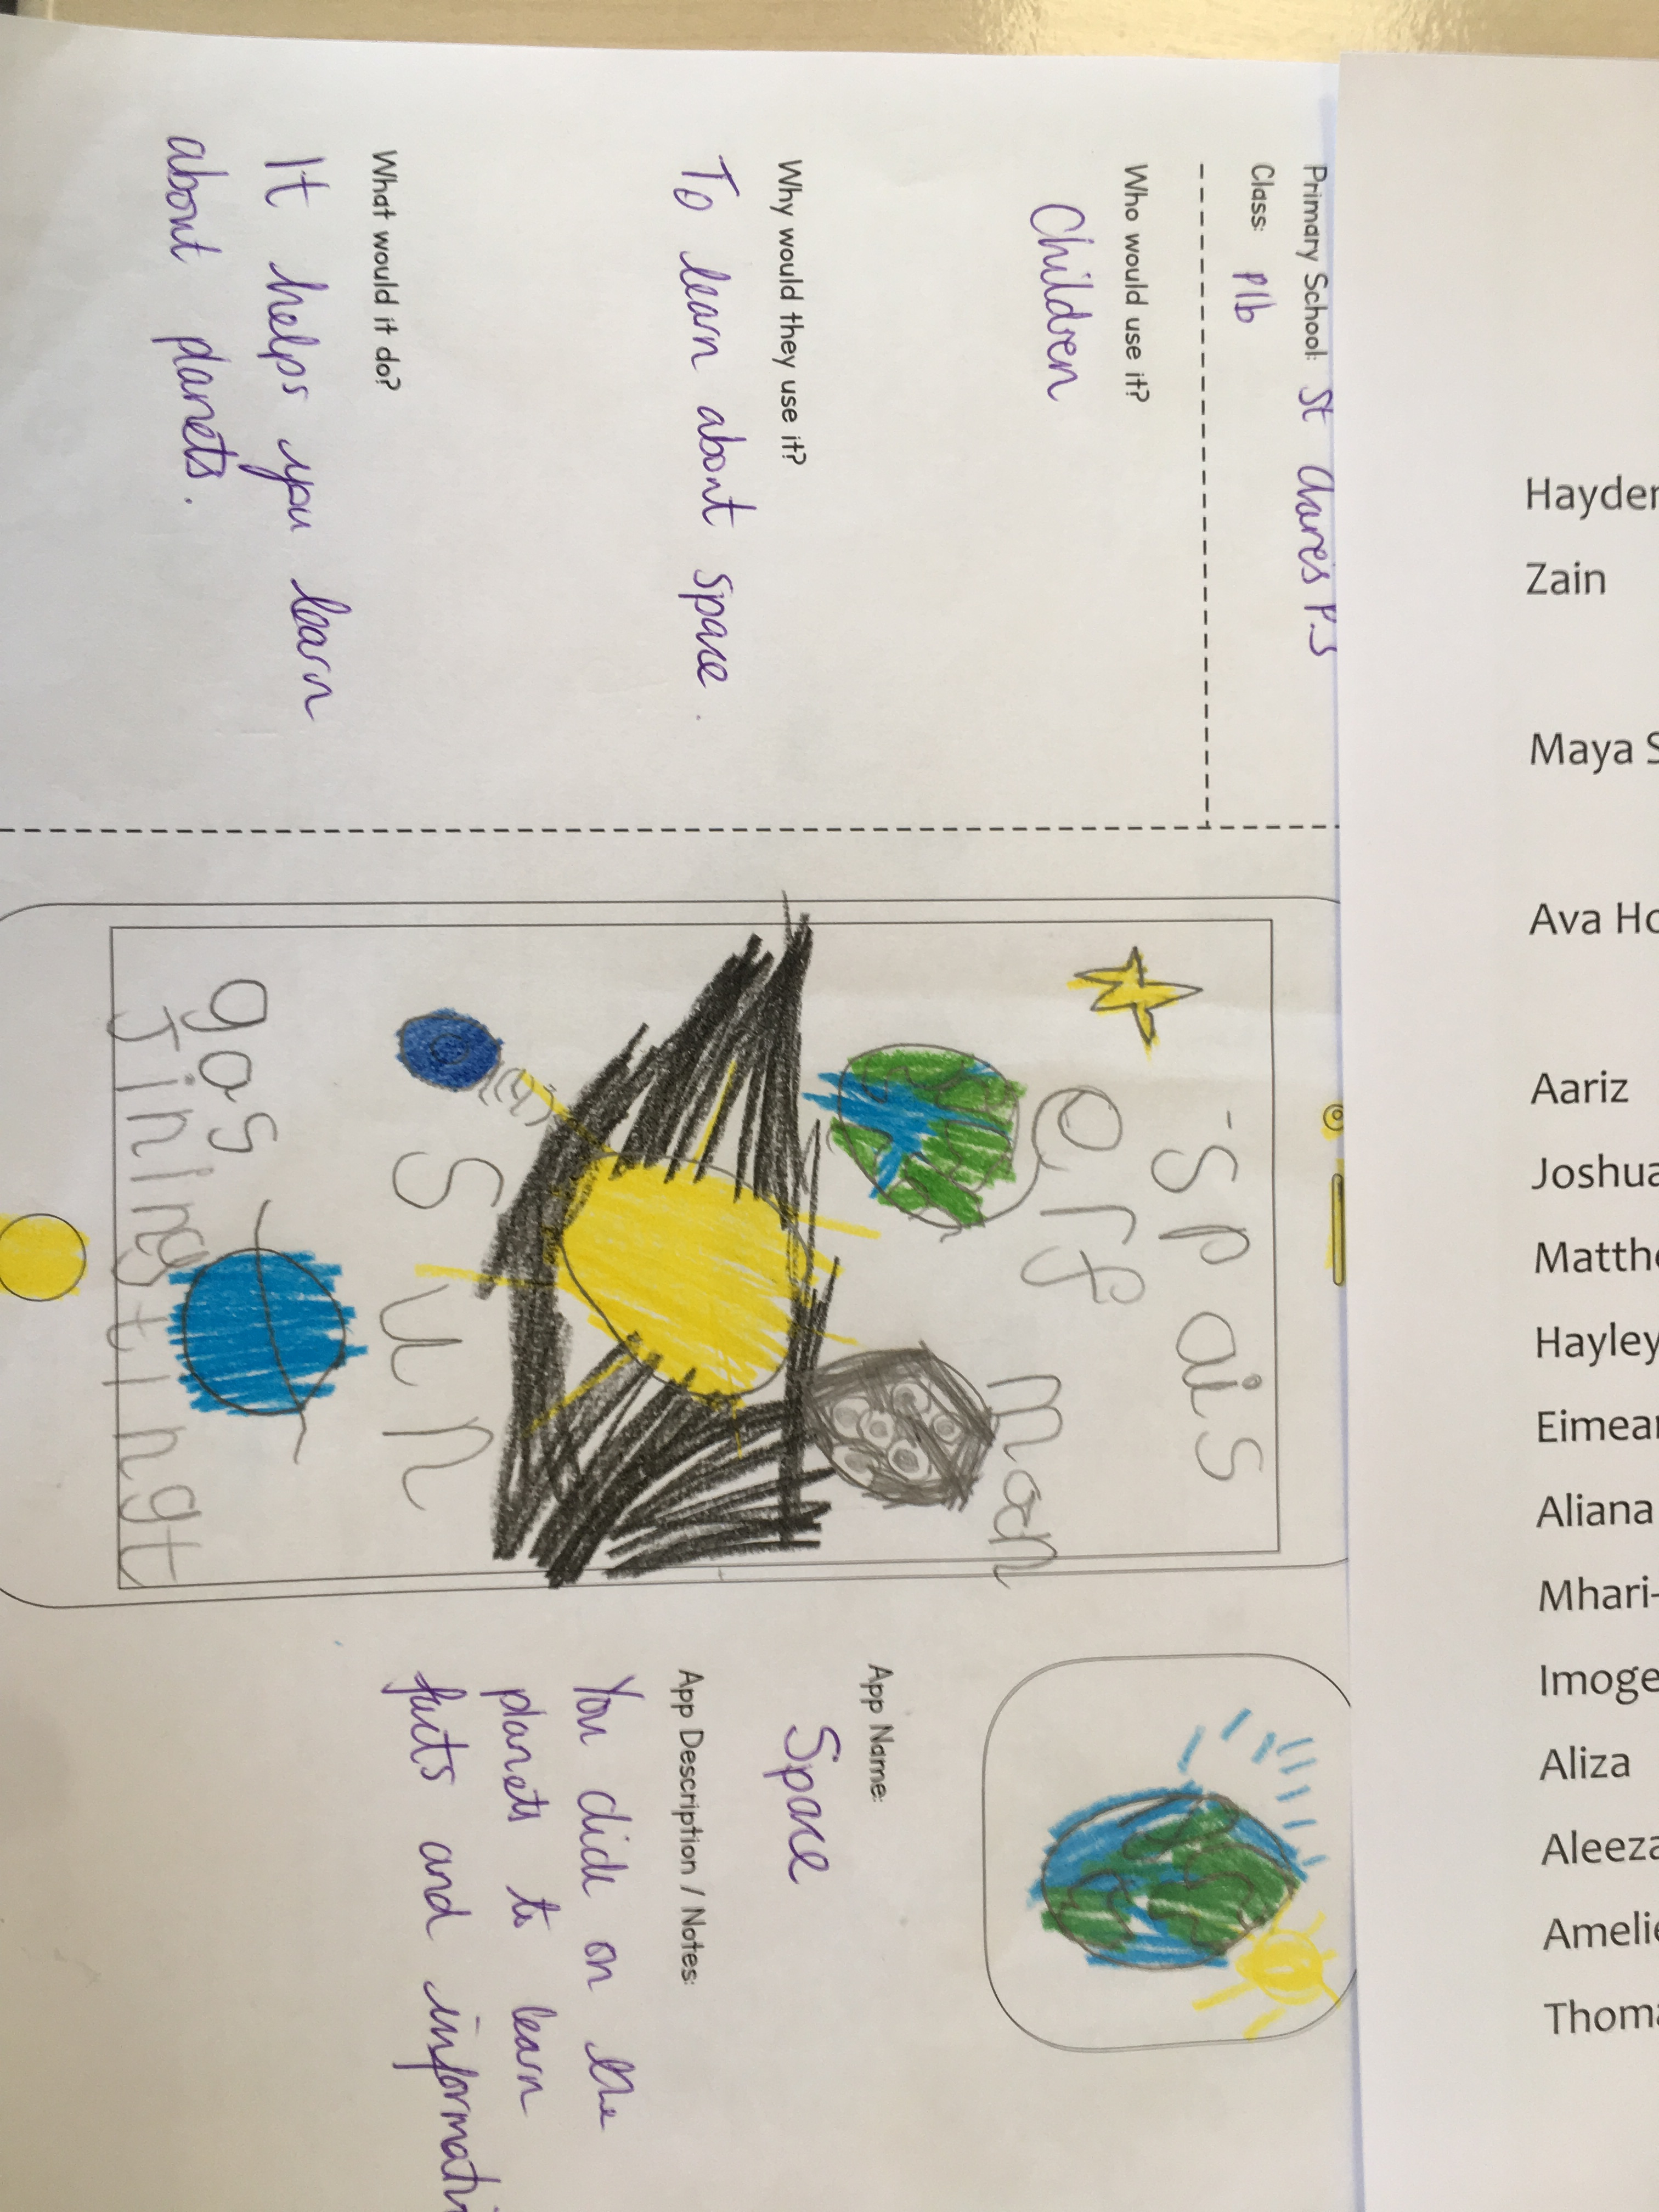
Runner up – Ava Howie P1B
Space
Picture of entry

Slide 7
Runners up - 2

Slide 8
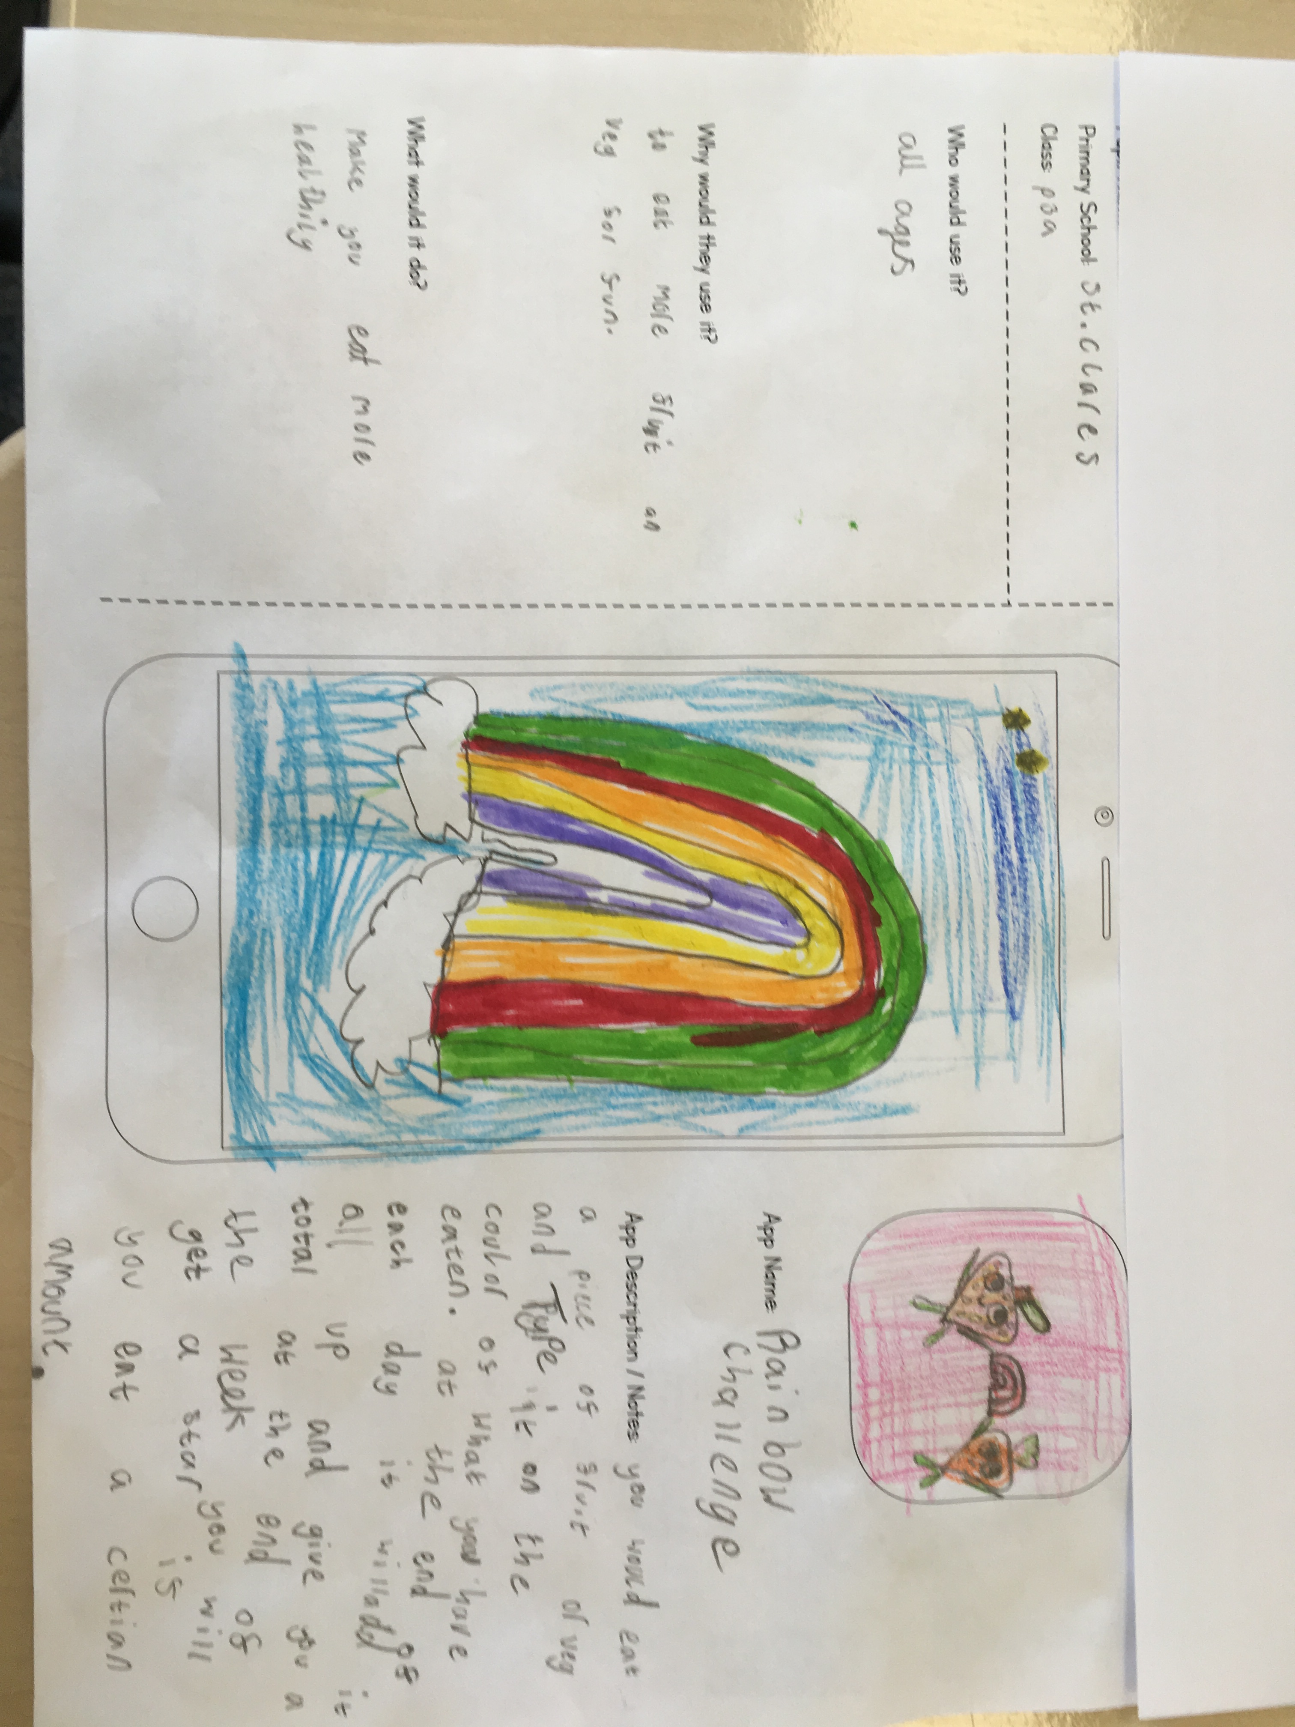
Runners up – Maya Sabharwal P3
Rainbow Challenge
Picture of entry

Slide 9
Winner

Slide 10
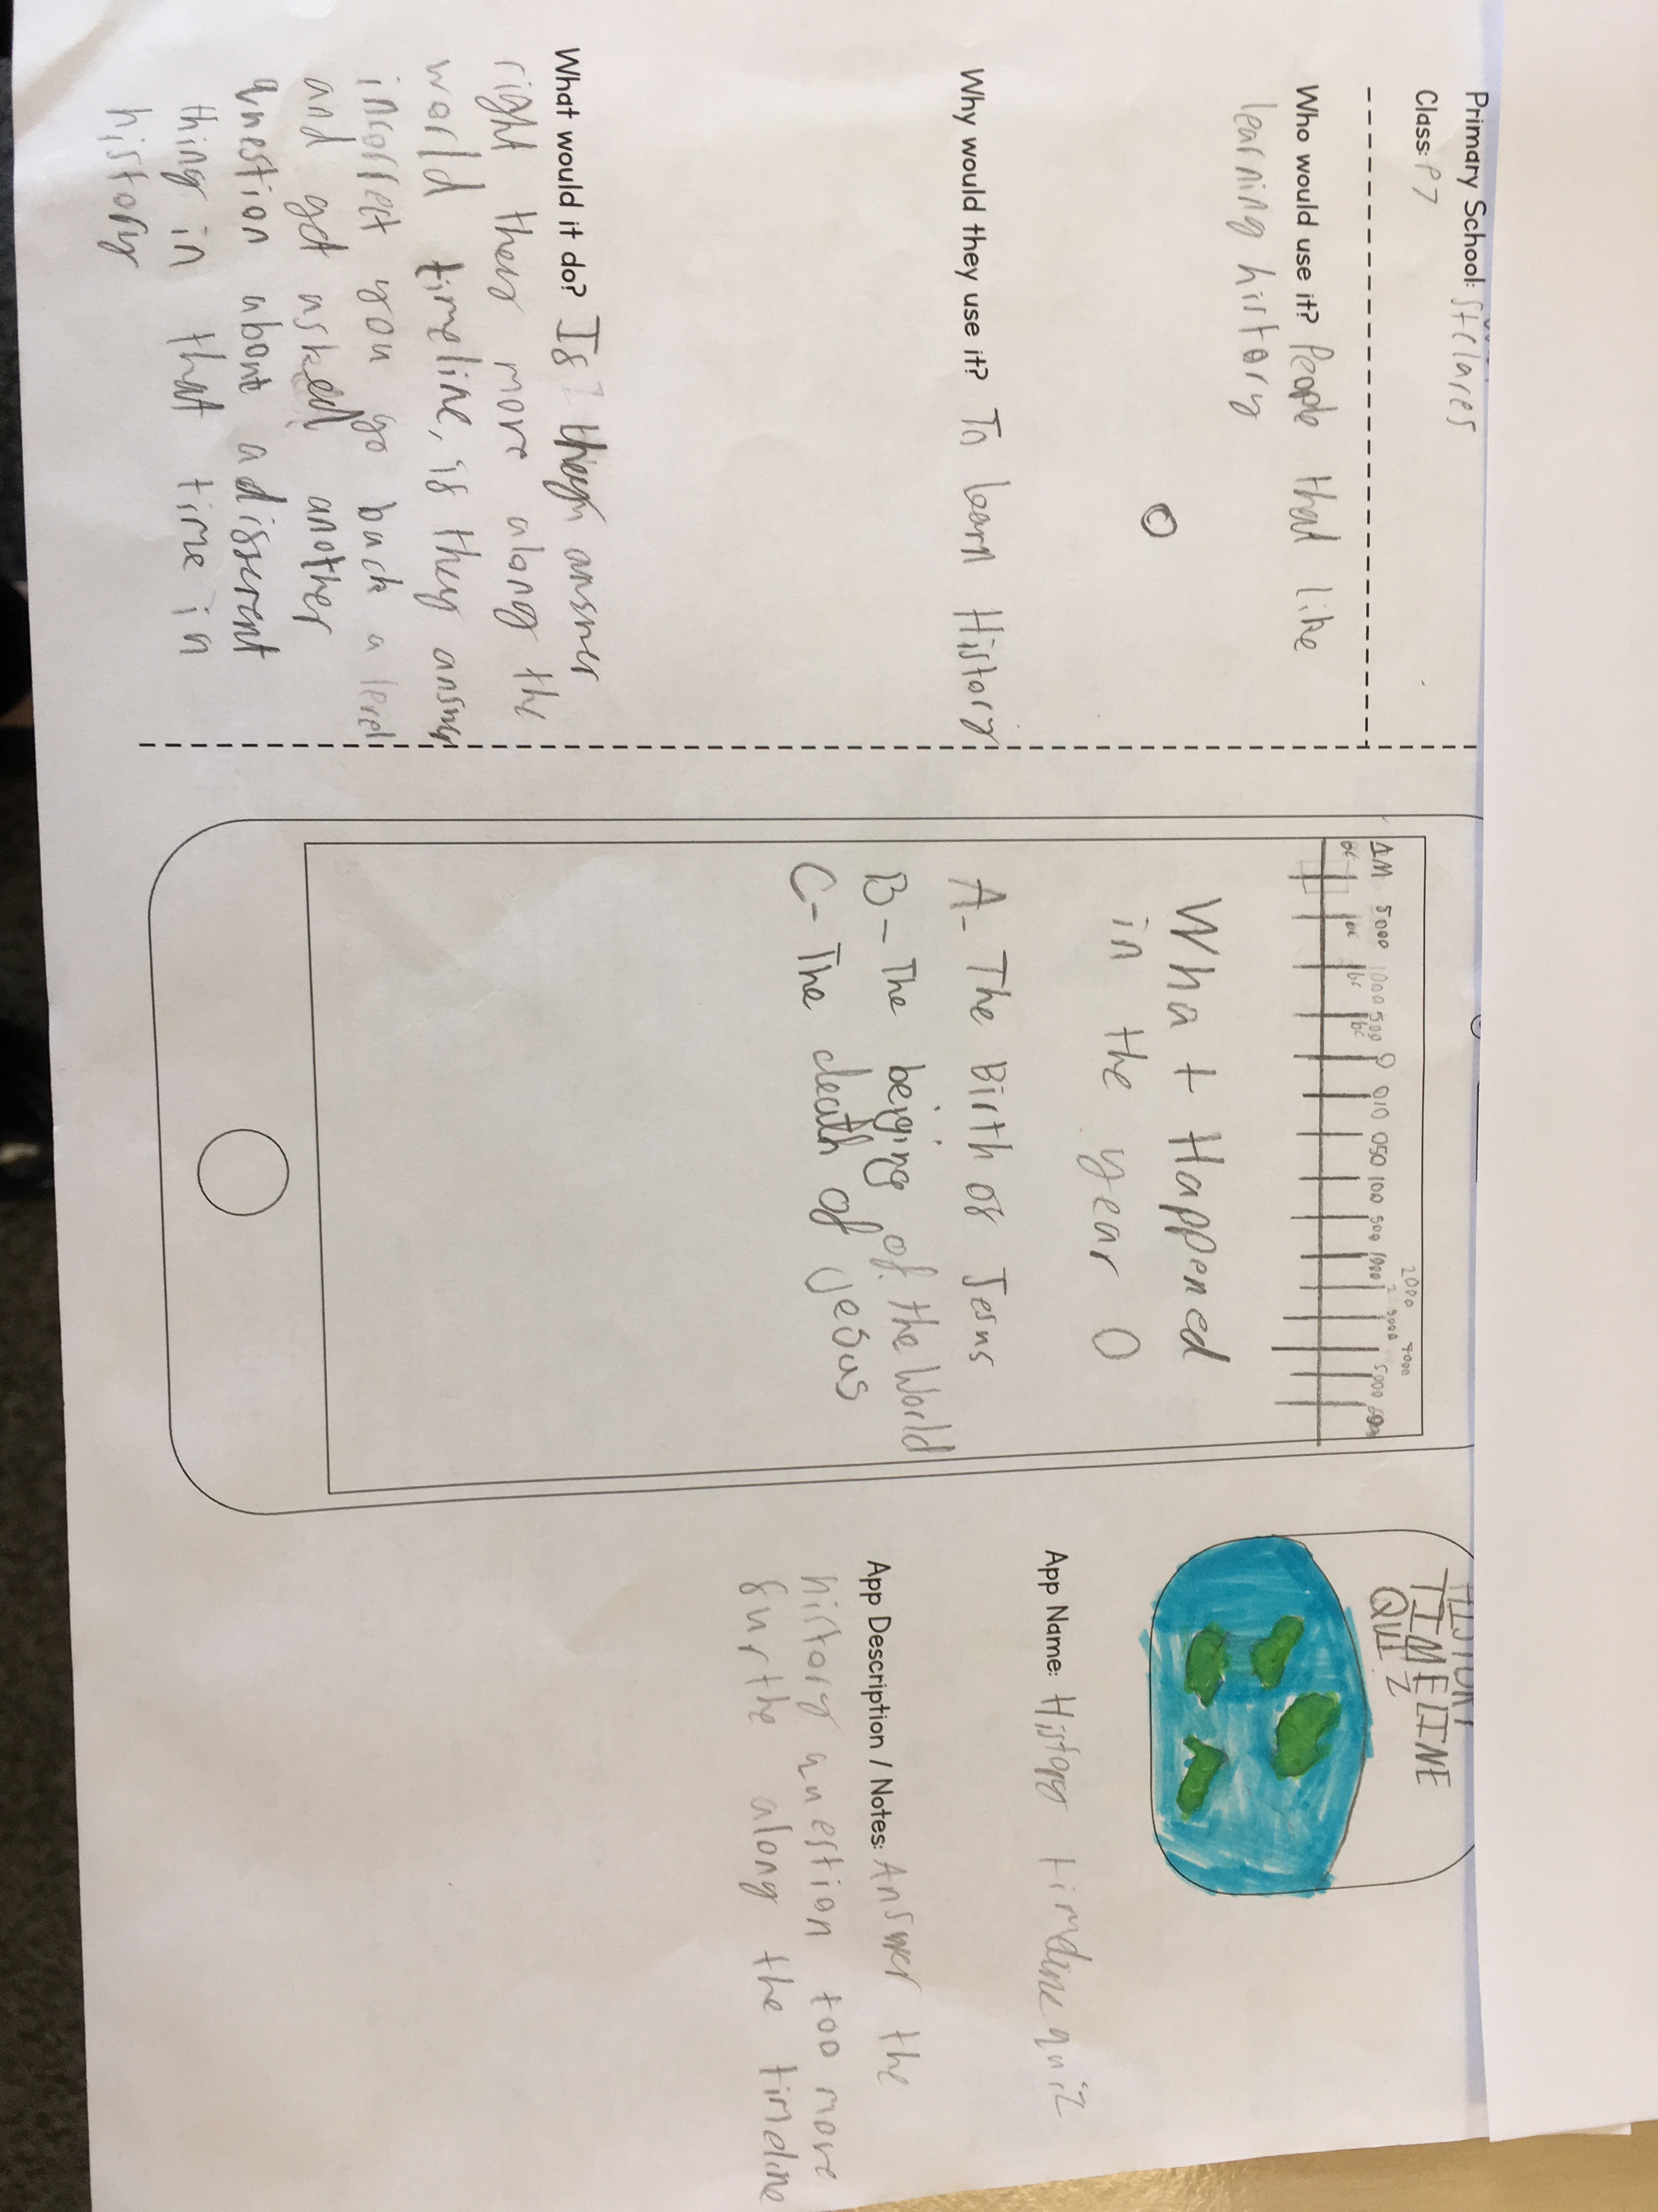
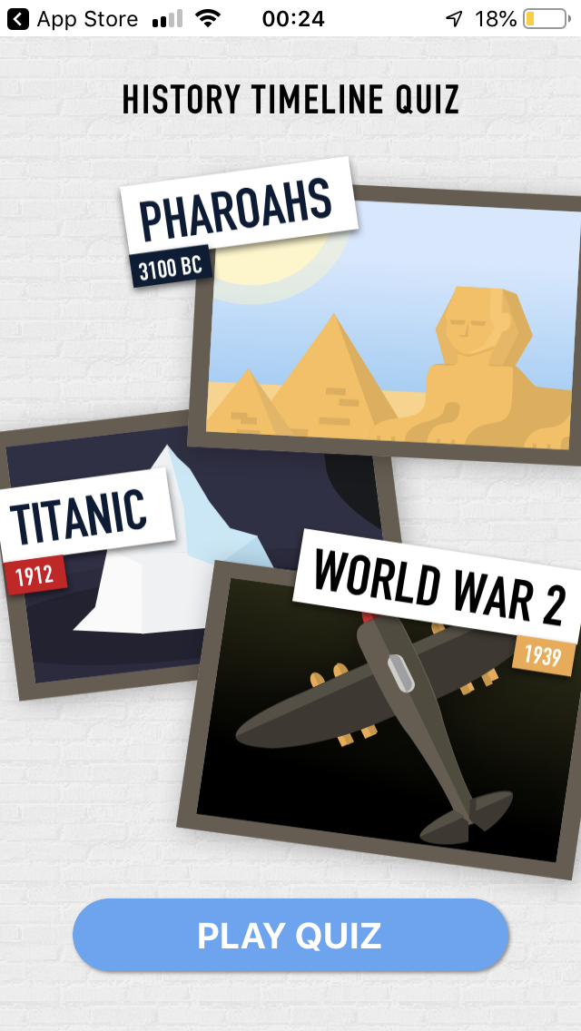
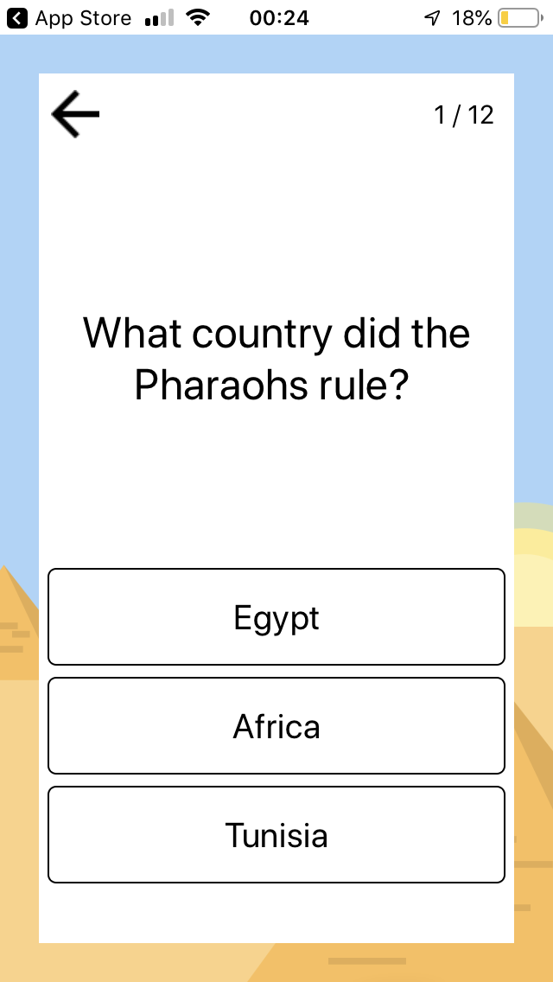

Winner – Hayden Cushing + Zain Akhtar P7
History Timeline Quiz
Picture of entry

Slide 11
What’s next…
Finish the winning app idea today
Download and play the winning app
You can take all your ideas forward – thunkable.com
Visit www.makeithappen.club

